Slide 1

NAME : ARKAPRATIM GHOSH
ROLL No. : 13000121058
REG. No. : 211300100110045
Paper Name: Introduction to Industrial Management (Humanities III)
Paper Code: HSMC-501
CSE, 5th Sem (2021-2025), CA-1

Slide 2

CONTENT
Introduction
Production Management
Operations Management
Human Resource Management
Financial Management

Slide 3
Introduction
Industrial management plays a vital role in ensuring the smooth functioning and success of businesses operating in various sectors.
Effective management practices are crucial for optimizing resources, enhancing productivity, and achieving organizational goals.
By understanding these different management areas, organizations can streamline their operations, boost efficiency, and remain competitive in today's dynamic business landscape.

Slide 4

Production Management
Core to manufacturing and product-based industries.
Involves planning, organizing, and controlling production processes.
Ensures efficient use of resources, time, and technology.
Key aspects: demand forecasting, capacity planning, scheduling.
Integration of technology for automation and data-driven decision-making.

Slide 5
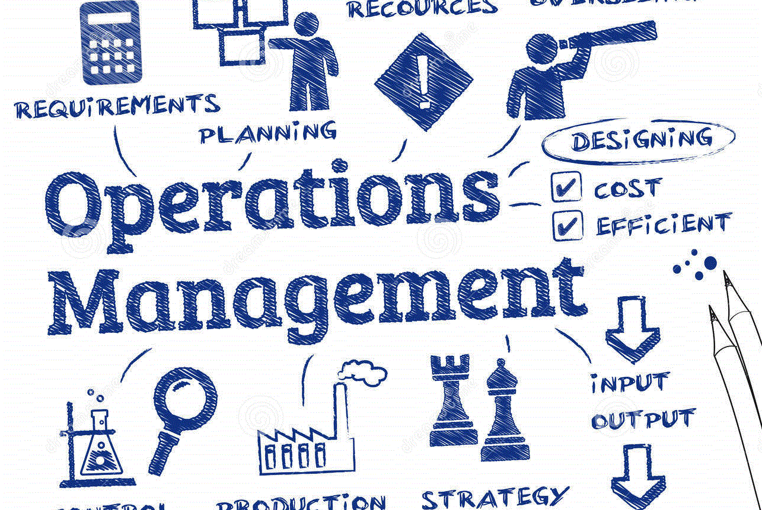
Operations Management
Focuses on overall efficiency and effectiveness of business operations.
Optimizes processes to achieve higher quality and lower costs.
Includes process design, workflow organization, and continuous improvement.
Involves supply chain management for timely sourcing and distribution.
Utilizes strategies like Lean, Six Sigma, and Total Quality Management.

Slide 6

Human Resource Management
Ensures effective management of the workforce.
Encompasses recruitment, training, performance evaluation, and employee development.
Fosters a positive work environment and employee well-being.
Plays a critical role in talent retention and succession planning.
Balances organizational needs with employee aspirations.

Slide 7

Financial Management
Responsible for prudent financial decision-making.
Involves budgeting, forecasting, and managing financial resources.
Ensures cost control, efficient resource allocation, and risk management.
Analyzes financial data to guide strategic planning and growth.
Impacts long-term sustainability and profitability.

Slide 8
THANK YOU

